Slide 1
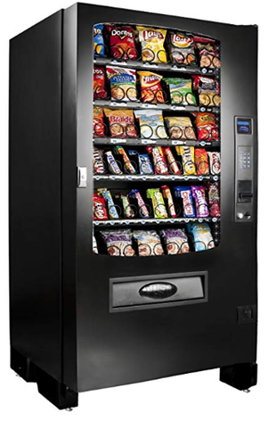
Vending Machine by
Shweta Yadav
Yukta Wagh
Preeti Vasaikar
Drishti Agrawal
Sachi Shah

Slide 2

CONTENTS
1
Introduction
2
Block Diagram
3
Working
4
List of Components
5
Advantages
6
Simulation
References

Slide 3
Introduction
Vending machine dispenses items such as snacks, beverages, alcohol, cigarettes, lottery tickets, consumer products, and even gold to customers automatically, after the customer inserts currency or credit into the machine
Large-scale retailing is possible through vending machines by placing it at a convenient location such as petrol pumps , railway stations , airports etc
The buyer inserts a coin or token in the machine and receives a specific quantity of product from the machine
There is no requirement of any employee or security to operate the vending machine
Older vending machines were mechanical, but most newer ones are electronic
Many modern vending machines accept debit or credit cards in addition to cash

Slide 4
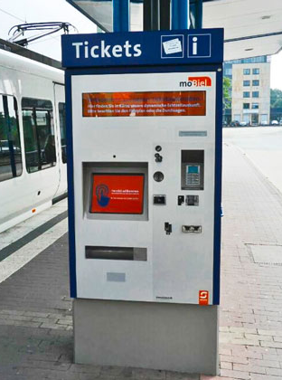
The first modern coin-operated vending machines were introduced in London, England in the early 1880s, dispensing postcards
Now, vending machines have evolved further and sell more varied products, such as :
Cigarettes Vending Machine
Food and snack vending machines
Newspaper vending machine
Stamp vending machine
Ticket machine, and the list goes on.

Slide 5
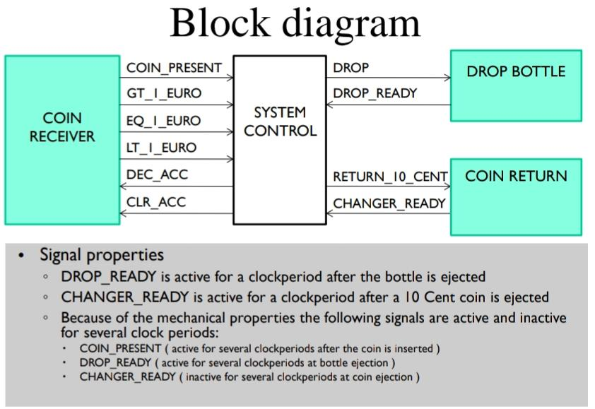
Block Diagram of a Vending Machine:

Slide 6
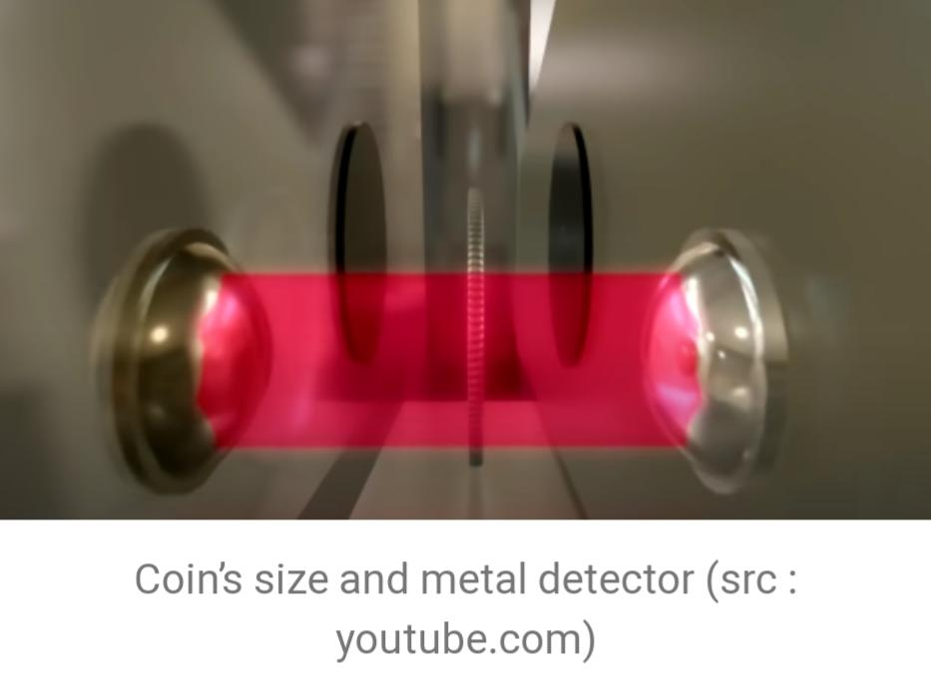
Working of a Vending Machine:
Vending machines use light sensors to measure the size of a coin and electromagnets to detect the material of coin
If it isn’t quite the right size, or was made using different material, then the coin will be rejected and go to the rejection chute, delivering it back to the customer
When it is the right coin, it will go on to the sorting section, where it is sorted and placed in the right column, based on the size
While the previous process takes place, the machine will be on idle, waiting for the customer to choose their snack.

Slide 7
Behind the keys, there is a mini-sized computer which keeps track of the payment, so if the payment doesn’t enough, particular snack cannot be accessed
The computer orders 1 out of 32 matchbox-sized motors, to turn the spiral coil 360 degrees, so the snack in the front side of the machine will fall into the release chamber, and the customer can take the snack out from the chamber
To overcome the problem of the snack getting stuck in the machine, when the snack falls to the chamber, it breaks a line of ten infrared beams
If nothing crosses the beam, that means the snack isn’t delivered yet
In that case, thr computer tells the motors to turns 360 degrees again, untill something crosses the beam, and the snack is delivered

Slide 8
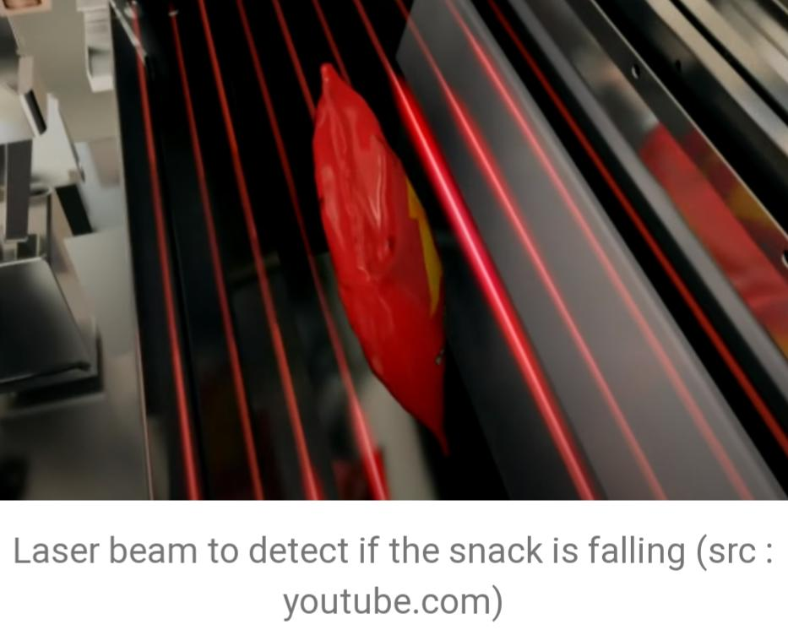
After that, the computer counts the right amount of change to be returned, and the chamber that has coloumn of stacked coin will release the coins one by one, untill the right changes has been delivered
Once in a certain period of time, the owner of the vending machine comes and restock the product, and also collect the money inside the machine
Maintenance of the machine is important to keep the machine working properly

Slide 9
Materials required for vending machine
Vending machines are constructed primarily from four major raw materials:
Galvanized steel
The bulk of the machine is constructed from galvanized steel ranging from 10 gauge to 22 gauge in thickness
The thicker gauges are used for the outside cabinet, external doors, and internal tank
Thinner gauges are used for internal doors and plates, can stacks, and mechanisms such as coin validators and product trays

Slide 10
Lexan or other plastic:
Lexan, a tough polycarbonate plastic, is used in the front panels of the vending machine
Product logos, names, and illustrations are silk-screened on Lexan sheets, which are installed in channels in the doors of the vending machines
Acrylic powder coatings :
Acrylic powder coatings are colored powders used to paint the surfaces of vending machines
Polyurethane insulation:
Polyurethane foam provides the insulation for the inside of the vending machine
In addition to thermal insulation, the stiff foam adds structural stability to both the cabinet and tank of the machine

Slide 11
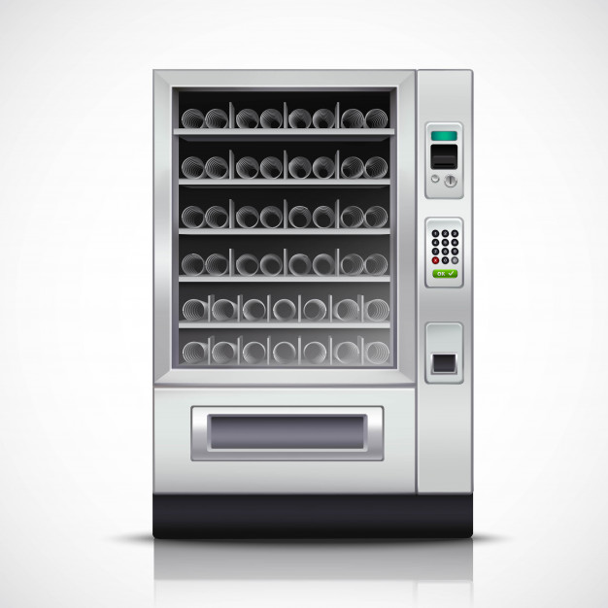
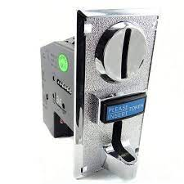
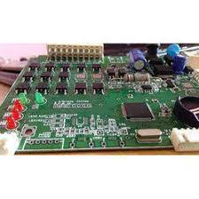
Some of the supplies required and their cost:
SR. NO. | MATERIAL | COST(₹)
1. | Vending machine motor | 7500
2. | Coin acceptor | 1500
3. | Machine body | 12,000
4. | Multi selection circuit | 4500
Multi selection circuit
Vending machine body
Coin acceptor

Slide 12
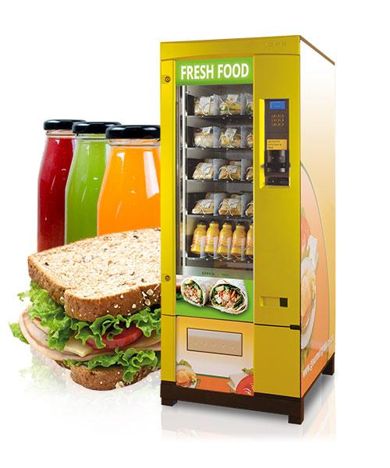
Applications of Vending Machine:
1. Food Vending Machine
Greatest application for vending machine is food or drinks like snacks or hot/cold drinks we get out of these machines
No issue of big queues, no time consuming distance, also no issue of product unavailability even at late night
Medicine Vending machine is also a latest technological evolution

Slide 13
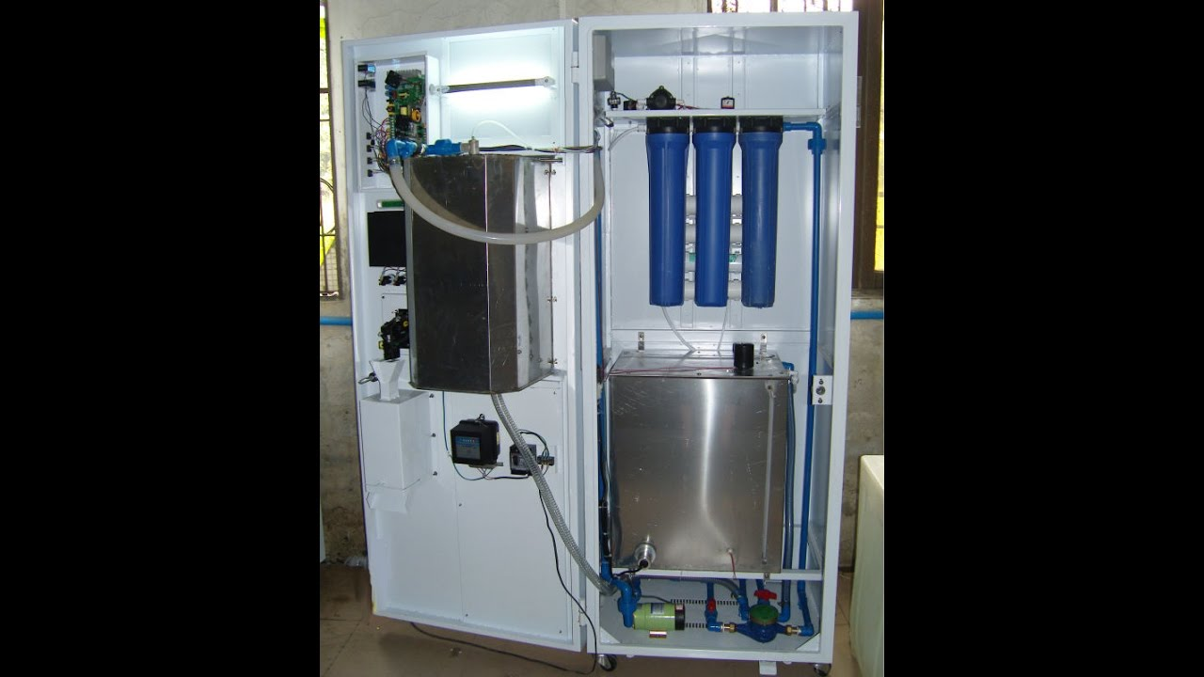
2. Water Vending Machine
A water vending machine is a sort of a water vending machine similar to bank ATMs except that in a water ATM, money goes in to the machine in return for water
These machines can run on a cash as well as card
It gives complete guarantee of safe water,dispenses pure water 24/7 ,reduces the dependence of packaged drinking water

Slide 14
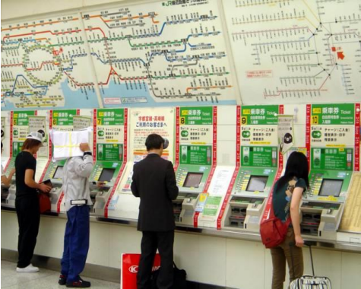
3. Lottery Vending Machine
Lottery distribution machine is the most
widely and commonly used machines all
the world, where people try their luck
with money and get their lottery tickets
instantly through the machine without
going in a store and waiting in a queue

Slide 15
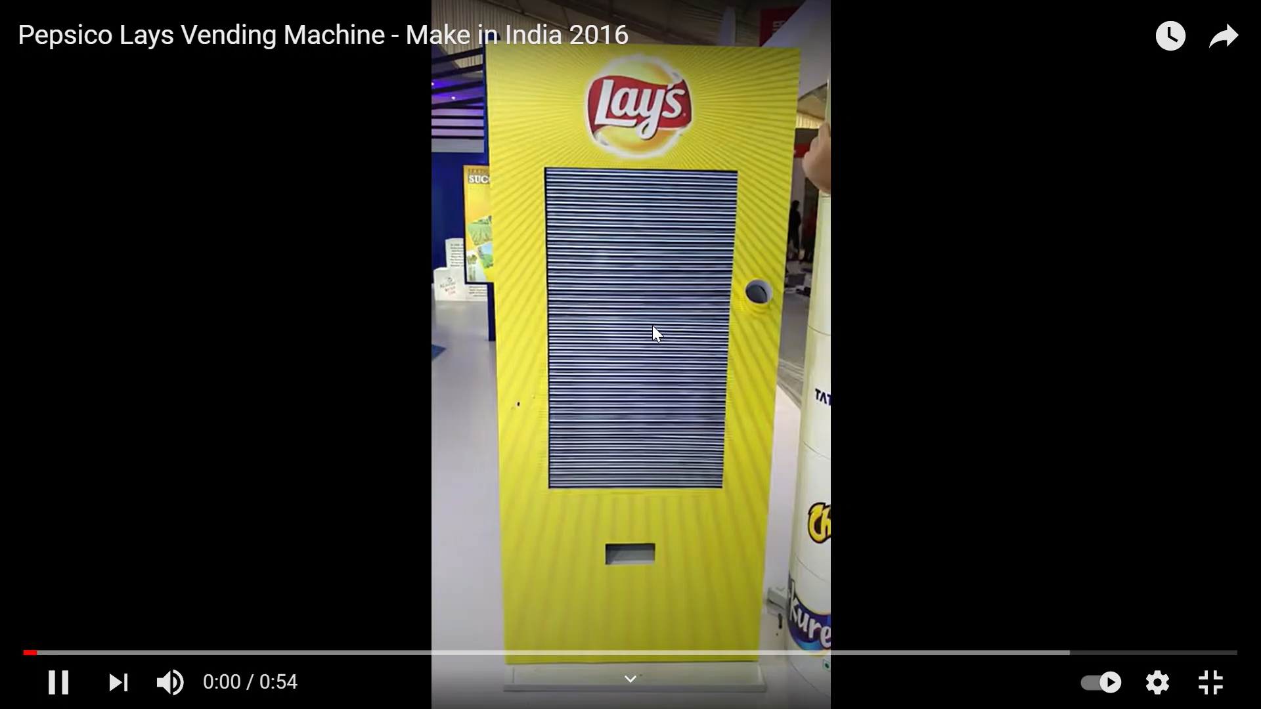

Slide 16
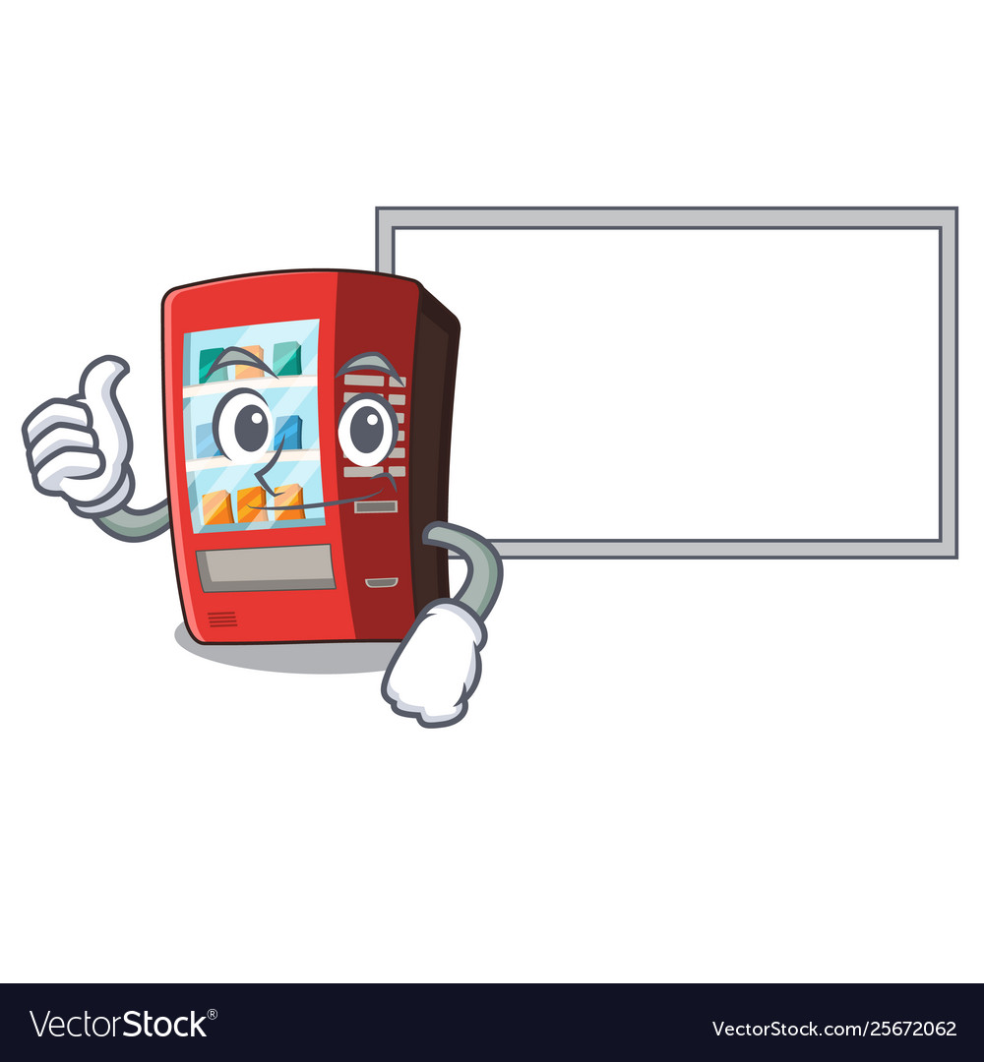
Advantages Of A Vending Machine
Advantage:
1)They have mobility
2)Vide range of products can be sold
3)Quick to use
4)Available 24/7
5)Less labour intensive

Slide 17
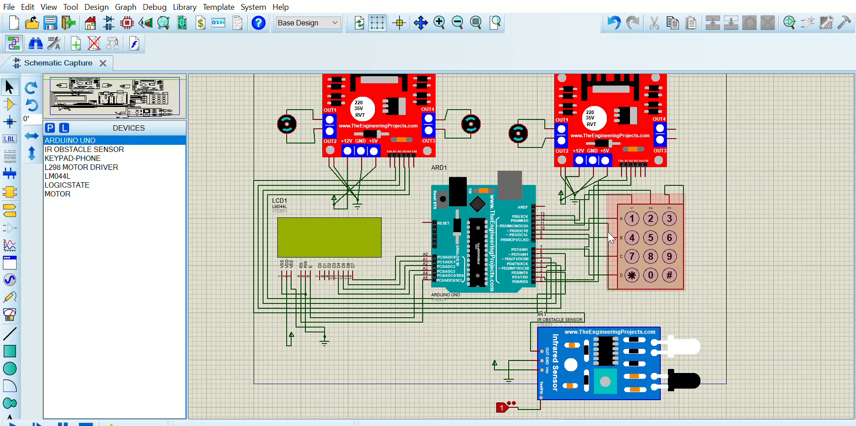

Slide 18
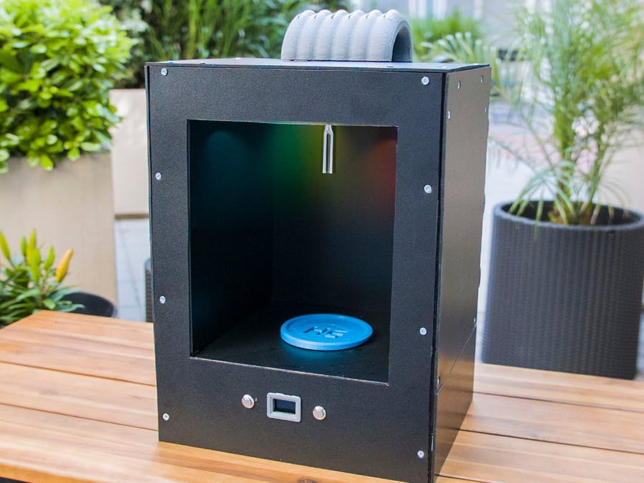
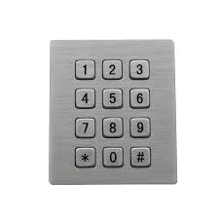
Cocktail Maker

Slide 19
Reference
https://medium.com/@ahandnr/how-does-vending-machine-works-1b75b44cb758
http://www.madehow.com/Volume-7/Vending-Machine.html
https://www.researchgate.net/publication/Vending_machine
https://www.tcnvending.com.au/blog/vending-machine-parts-closer-look/

Slide 20
Thank you

